Slide 1

Flight Delay Analysis
✈ An Insightful Examination of Airline Delays Using Data Analysis tools
Team Members:
Alfahad Ali
Rukhsar Karim Pathan
Afiya Mohammed Rafi
Soham Deshmukh
Subhojit Deb
Mentor:
Arun Math

Slide 2
Datasets Overview
📁 Files Used
flights.csv – 100,000+ records of flight operations
airlines.csv – IATA codes mapped to airline names
airports.csv – Airport codes with city, state & geolocation
📌 Key Information Extracted
Flight delays (departure & arrival)
Flight scheduling & distances
Airline and airport identifiers
Cancellation/diversion status
Date context: flight day, weekday/weekend

Slide 3
Data Cleaning Process
1. Flights Data (flights.csv)
Removed incomplete & blank rows
Standardized date format (yyyy-mm-dd)
Created helper columns:
Day name, weekday/weekend flag
Week number, delay status
2. Airlines Mapping (airlines.csv)
Used VLOOKUP to convert IATA codes → full airline names
Airlines sheet embedded in master workbook for reference

Slide 4
Airport Mapping & Final Output
3. Airport Location Mapping (airports.csv)
Added city & state for origin and destination airports
Used VLOOKUP to match IATA codes with locations
4. Final Checks
Clean column names and structure
Removed temporary formulas (paste values only)
Verified for missing/N/A entries
✅ Output File:
Cleaned_DataSets.xlsx
Ready for KPIs & dashboards

Slide 5
KPI 1 – WEEKDAY/WEEKEND FLIGHT ANALYSIS OVERVIEW
Key Objectives:
✅ Measure average arrival delays on weekdays vs weekends to assess punctuality performance.
✅ Compare the total number of cancelled flights across weekdays and weekends to understand cancellation trends.
✅ Analyze total flight count to understand traffic distribution and operational load differences.
✅ Identify insights that support scheduling, resource planning, and service optimization.

Slide 6
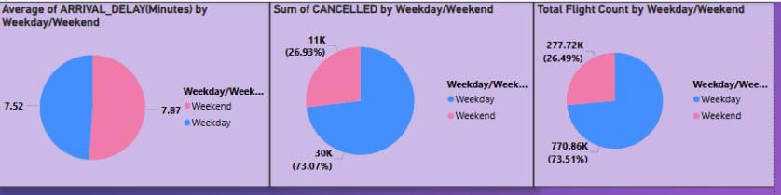
VISUAL ANALYSIS – WEEKDAY/WEEKEND

Slide 7
Problems and suggestions
Problems Identified:
1.Uneven Flight Distribution
2.Data Inconsistency or Missing Days
3.Seasonality Ignored
4.Inadequate Context Without Delay/Cancellation Overlay
Suggestions for Improvement:
1.Use data-driven scheduling to optimize flight timings/routes with low or high demand.
2.Recommend redistributing flights to off-peak times or days to maximize resource utilization (aircraft, crew, airport slots).
Implement dynamic pricing based on demand trends.
3.Incorporate seasonality trend lines (monthly, quarterly) to capture peak/off-peak behavior.
4.Use year-over-year comparisons to identify seasonal spikes or drops.

Slide 8
KPI 2 – jetblue Airways Cancellations
Objective:
To identify the total number of cancelled flights for the jetblue airways on the first date of every month.
Scope:
Focused on the cancelled jetblue flights on the first day of every month.
Includes all airlines in the dataset.
Data Source: Cleaned Flights Dataset (Power BI Analysis)

Slide 9
Business Significance
✅ Identify and address the root causes of cancellations, which directly impacts customer loyalty and brand reputation.
✅ Optimize scheduling and resource allocation, improving overall operational performance.
✅ Support financial forecasting by understanding the economic impact of cancellations on revenue and costs.
✅ Provide valuable insights to stakeholders to make informed decisions that align with the company’s strategic goals of minimizing disruptions and ensuring a seamless travel experience for passengers.

Slide 10
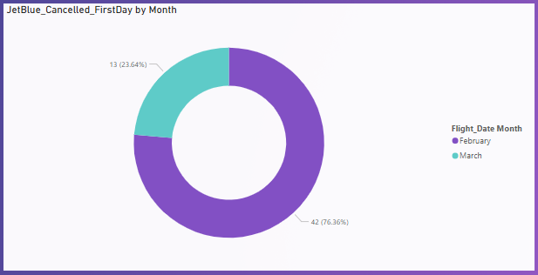
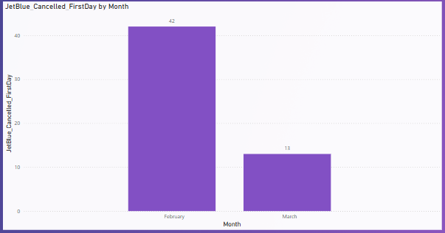
Visual Analysis :- Bar chart and pie chart
Insights :-
January has no cancelled flights.
March has 13 cancelled flight on the first day.
And February has the most cancelled flights.

Slide 11
SUGGESTIONS
Strengthen staffing during peak months.
Invest in weather mitigation planning.
Enhance customer communication.

Slide 12
KPI 3 – FLIGHT DELAY ANALYSIS BY STATE, CITY AND WEEK
Objective: Identify patterns of flight arrival delays to assist airline operations and strategic planning.
Scope: Analysis across three dimensions: Geographic (State & City) and Time-based (Week-wise).
Data Source: Merged cleaned flight data analyzed using Power BI.
Significance: Helps detect regional bottlenecks, seasonal delay peaks, and operational inefficiencies.

Slide 13
PROBLEMS &CHALLENGES IDENTIFIED
Delay disparity across regions: certain states (e.g., Colorado, Kansas, South Carolina) and cities (e.g., Denver, West Palm Beach) consistently report high average delay times.
Unpredictable weekly trends: delay patterns show spikes in week 6 and week 9, indicating possible seasonal/weather impact or operational gaps.
Lack of real-time monitoring: airlines might not have visibility on where delays build up most frequently, resulting in poor passenger experience.
Economic impact: persistent delays lead to increased costs (fuel, staff overtime) and decreased customer satisfaction.

Slide 14
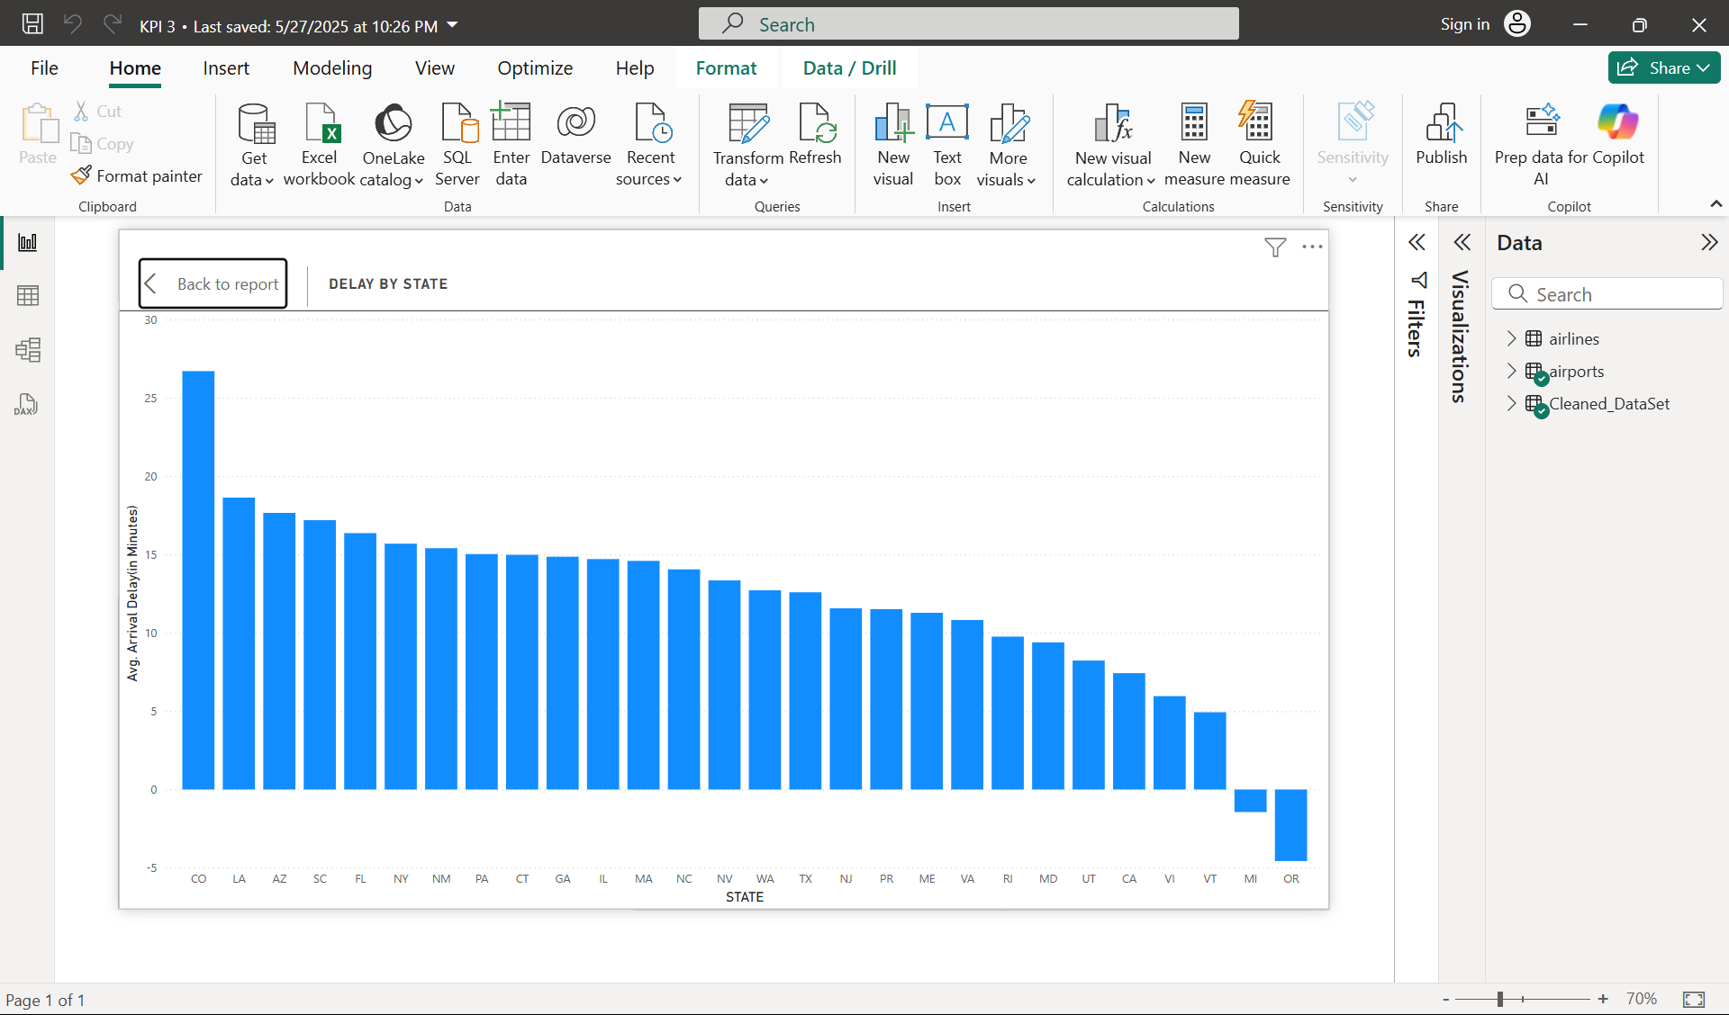
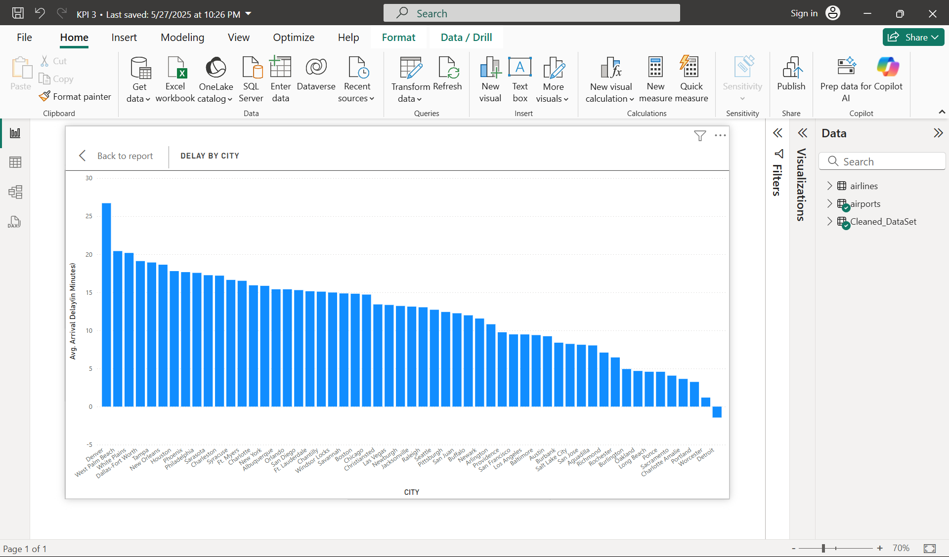
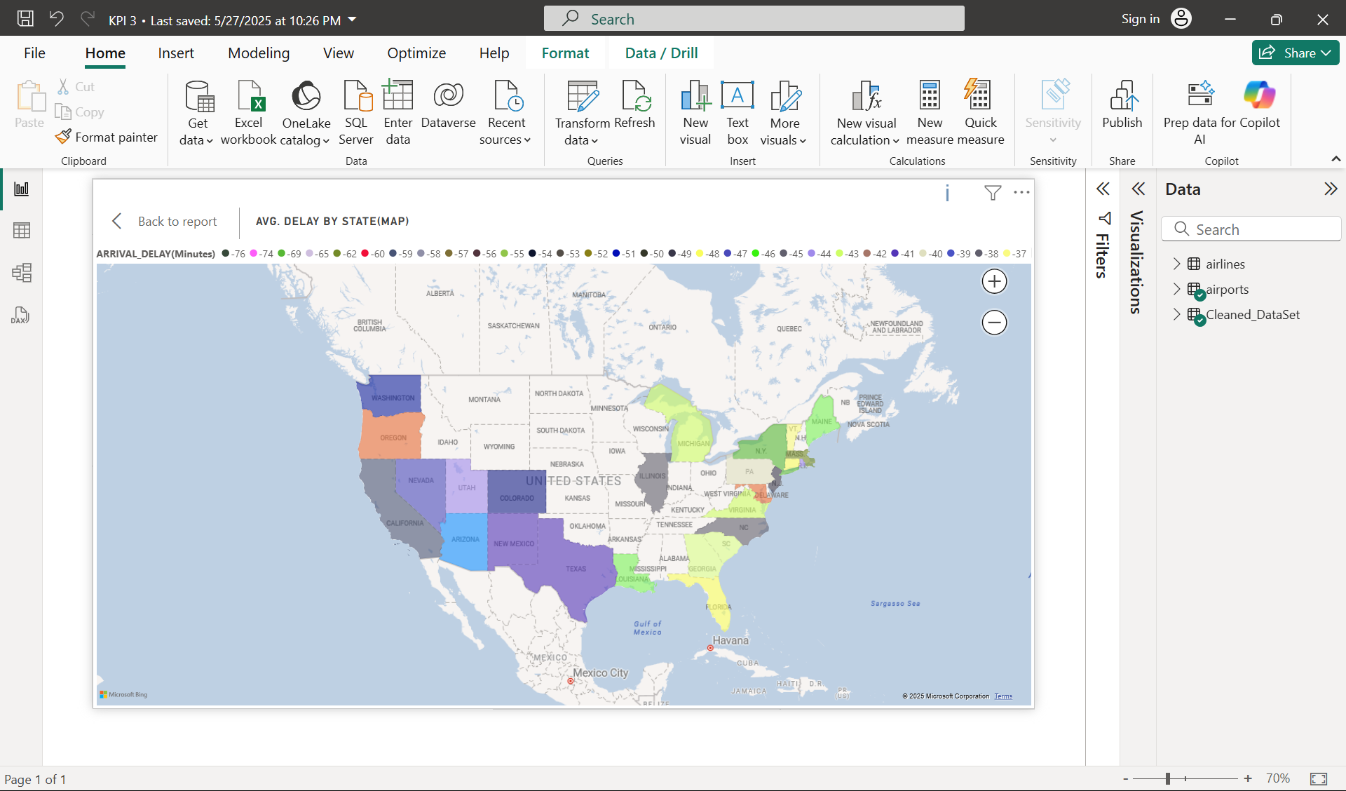
VISUAL ANALYSIS – DELAY BY STATE AND CITY

Slide 15
STATE AND CITY-LEVEL DELAY PATTERNS
Top 5 delayed states: Colorado (co), South Carolina (sc), Kansas (ks), Pennsylvania (pa), and Alabama (al) have the highest avg delay (20+ min).
Top 5 delayed cities: Denver, West Palm Beach, Dallas/Fort Worth, New Orleans, and New York.
State map insight: darker shades indicate higher delays; clearly highlights southern and central u.s. as high-delay regions.
This helps prioritize locations for operational improvement.

Slide 16
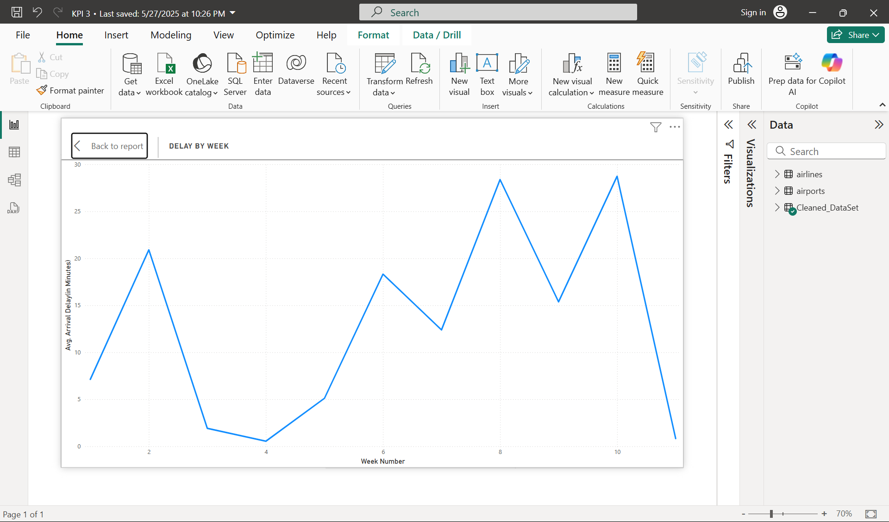
TIME-BASED DELAY TRENDS
Spikes in week 6 and week 9: delay times reach nearly 30 minutes on average, compared to <10 minutes in weeks 2 & 4.
Inconsistency in performance: suggests reactive scheduling rather than proactive planning.
Indicates the need for predictive maintenance and dynamic crew planning.

Slide 17
SOLUTIONS & STRATEGIC SUGGESTIONS
•Geo-targeted planning: increase staff and aircraft availability in high-delay cities (denver, west palm beach).
•Root cause analysis: investigate issues specific to weeks with peak delays – possibly related to weather, staffing, holidays, or maintenance cycles.
•Predictive analytics: use historical data to forecast delay-heavy weeks and prepare accordingly.
•Collaborate with airports: especially in problem areas, work with ground operations to improve turnaround time.
•Continuous monitoring: create a power BI alert system for early detection of rising delays.

Slide 18
KEY TAKEAWAYS FROM KPI 3
Significant delay clusters exist by state, city, and week.
Power BI enabled multi-dimensional analysis: spatial + temporal.
Insights gained will support better resource allocation, crew management, and customer satisfaction strategies.
Ultimately, this KPI supports the airline’s goal of operational efficiency and reliability.

Slide 19
KPI 4 – On-Time Long-Distance Flight Performance
Objective:
To identify airlines that perform best in maintaining on-time performance over long-distance routes (2500–3000 KM) with zero arrival and departure delay.
Scope:
- Focused on flights between 2500–3000 KM
- Includes all airlines in the dataset
- Evaluates only those flights with zero delay
Data Source: Cleaned Flights Dataset (Power BI Analysis)

Slide 20
Business Significance
- Highlights the best operational performers in long-haul flight punctuality
- Assists in identifying reliable partners and benchmarking standards
- Enables better decisions in airline partnerships and service strategy
- Useful for improving customer satisfaction and loyalty strategies

Slide 21
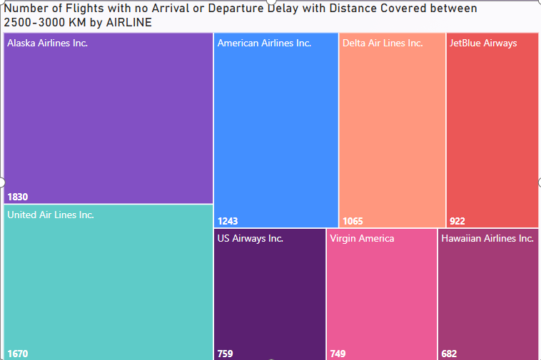
Visual Analysis – Treemap Title: Number of Flights with No Delay (2500–3000 KM Range)
Insights:
- Alaska Airlines Inc. leads with 1830 on-time long-distance flights
- United Airlines Inc. also performs strongly with 1670
- Virgin America and Hawaiian Airlines show low reliability in this range

Slide 22
Key Findings & Strategic Suggestions
Only select airlines manage high on-time performance in long routes
Alaska and United are consistently reliable
Others need to address operational gaps
Insights can guide long-route expansion and fleet planning
Benchmark operations with Alaska and United
Use analytics to anticipate delay patterns and optimize routes
Improve turnaround and crew scheduling processes
Focus on improving consistency in long-distance flight reliability

Slide 23
Conclusion – Key Findings
📊 Overall Insights from KPI Analysis:
KPI 1 – Weekday vs Weekend Analysis:
Weekends tend to have higher average delays and cancellations.
Uneven flight distribution and lack of seasonality consideration hinder performance tracking.
KPI 2 – JetBlue Cancellations:
February had the highest number of cancellations.
March cancellations were spiked on a single day — suggesting isolated operational issues.
KPI 3 – Delay by Location and Time:
States like Colorado, Kansas, and South Carolina have persistent delay issues.
Delay spikes in Week 6 and 9 suggest weather or planning issues.
KPI 4 – On-Time Long-Distance Performance:
Alaska Airlines and United are top performers for punctual long-haul flights.
Virgin America and Hawaiian Airlines show performance gaps in this category.

Slide 24
Strategic Recommendations
✈ Suggested Operational Improvements:
Dynamic Scheduling & Route Optimization:
Redistribute flights based on demand patterns and delay trends.
Implement data-driven scheduling and capacity planning.
Predictive Analytics:
Use historical trends to forecast delay-heavy periods (e.g., Weeks 6 & 9).
Introduce real-time monitoring systems via Power BI alerts.
Targeted Investments:
Focus on high-delay regions (Denver, West Palm Beach) for infrastructure or staffing.
Improve communication systems and staffing in peak months (e.g., February).
Benchmarking & Partnerships:
Benchmark long-haul performance against leaders like Alaska Airlines.
Use insights to select reliable airline partners and improve customer trust.

Slide 25
THANK YOU!

